Slide 1
Carrying out Investigations & Writing Lab Reports
Criterion B

Slide 2
Criterion B – Planning an Investigation
A full Criterion B contains the following:
Research Question
Hypothesis
Variables
Materials
Method
Note: In your E Assessment, you could be asked to complete some or all of these steps in a given question.
Read the question carefully to determine what is required of you. Don’t write a full method if the question only says “describe how you will collect the data” and don’t write a full variables section if the question says “state the variables”, etc. Just do as asked!

Slide 3
Research Question
The research question is should describe the problem being tested and should be written as a question which includes both variables in the correct order, (ie. independent variable comes first, dependent variable comes second). You should also include extra details such as the range for the IV, how the DV will be measured and which control variables will be kept the same. Although this may not always be required in every markscheme, it is still good practice.
Remember the independent variable is the one that you decide how it changes at the start of the experiment. The dependent variable is the one that you measure how it changes in response to the independent variable.
The control variables are those that are kept constant throughout the experiment.
Note: The reason the control variables are kept the same is to avoid any other factors from influencing the DV other than the IV, or to prevent any unplanned changes to the IV.
Tip: The independent variable is the one where you can write the results in your table before you begin the investigation, because you choose these values. You can only write the results for the dependent variable as you complete the experiment because you measure these. This is also why the IV column should always be the first column in a results table.

Slide 4
Research Question
Task: Create a research question which could be used to determine the relationship between temperature of water and solubility of salt.
I could do this experiment by changing the temperature of the water and measuring the solubility of the salt in the water at each temperature. Now I need to make a Research Question.
Tip: I need to think about what my variables are and how I am going to measure them. I also need to think about my CVs.
In this case independent variable would be temperature and the dependent variable would be the solubility, but how do I measure solubility? I could measure it as the amount of a substance that is able to dissolve, but what do I mean by amount? I could measure the mass or the volume of salt dissolved. I need to be specific.
Two Examples: Observe the difference between the two Research Questions and determine why they have received that level.
L 3-4 RQ: How does the temperature affect the solubility of a substance?
L 7-8 RQ: How does changing the temperature of a solvent, measured in ºC using a thermometer, for a range of 20, 25, 30, 35 and 40 ºC, affect the solubility of a solvent, measured as the mass of solute dissolved per mL of solvent (g/mL) that can be dissolved in a beaker of water while keeping the type of solvent, volume of solvent and rate of stirring the same throughout?

Slide 5
Hypothesis
This is an Educated Guess/Prediction as to what you think is the possible outcome, reason or relationship being investigated. This is NOT a question, but a statement that includes what your prediction is based on what is happening. It must be in the form “If .…. , then... , because..…”.
Eg. If the (insert independent variable) increases/ decreaes (choose one) then the (insert dependent variable) will increase/decrease, (choose one) because (give a scientific explanation).
You get a higher grade for this section if your “because” statement uses correct and detailed scientific reasoning to explain it. This is your chance to show your scientific understanding of the concept being investigated. Use what you know about the concepts involved.
Note: You may also need to give some quantitative reasoning. For example, if you think your relationship is directly proportional, based on any known or given formula, then you should state that as one variables doubles, the other will double. If you think they are inversely proportional, state that as one variable doubles, the other variable will halve.

Slide 6
Hypothesis
Two Examples: Using the same Research Question as before, observe the difference between the two Hypothesis's and determine why they have received that level.
L 3-4 Hypothesis: If the temperature of the solvent increases then the solubility will also increase because the water contains more energy to break down and dissolve more of the salt.
L 7-8 Hypothesis: If the temperature of the water increases then the solubility, measured as mass of salt dissolved per mL, will also increase because water molecules at a higher temperature contain more kinetic energy. This increases the energy of the collisions between water molecules and the salt particles and also causes an increased number of collisions which allows more of the salt to be dissolved. The energy provided is also used to break down the bonds between the Sodium and Chloride ions within the salt molecule allowing them to form bonds with the water molecules.
Note: This specific example relates to solubility and requires you to understand how and why salt molecules can be dissolved in water. This is more of a chemistry topic, but the process is what is important here. The questions in the assessment may be based on concepts that you have covered in class, or they could be completely unfamiliar.

Slide 7
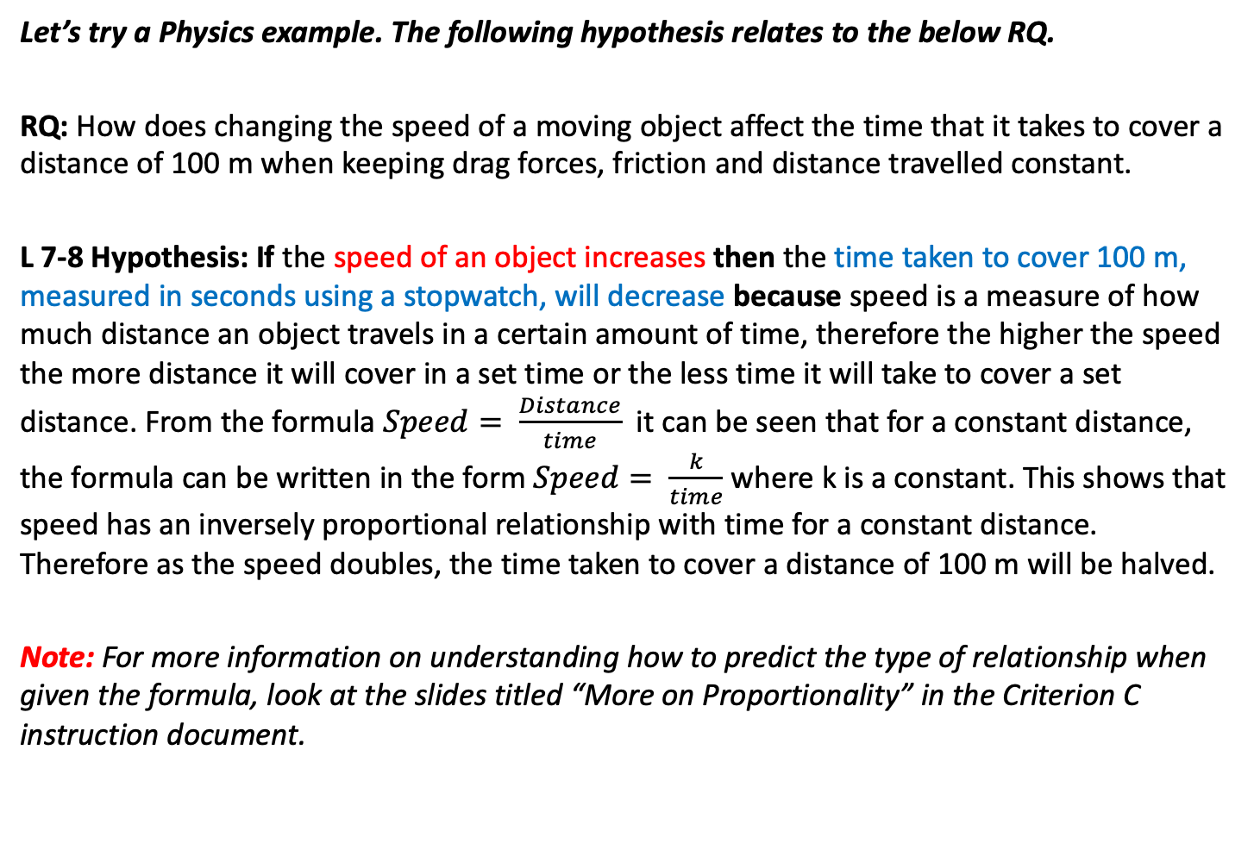
Hypothesis
Let’s try a Physics example. The following hypothesis relates to the below RQ.
RQ: How does changing the speed of a moving object affect the time that it takes to cover a distance of 100 m when keeping drag forces, friction and distance travelled constant.
L 7-8 Hypothesis: If the speed of an object increases then the time taken to cover 100 m, measured in seconds using a stopwatch, will decrease because speed is a measure of how much distance an object travels in a certain amount of time, therefore the higher the speed the more distance it will cover in a set time or the less time it will take to cover a set distance. From the formula $Speed= \frac{Distance}{time}$ it can be seen that for a constant distance, the formula can be written in the form $Speed= \frac{k}{time}$ where k is a constant. This shows that speed has an inversely proportional relationship with time for a constant distance. Therefore as the speed doubles, the time taken to cover a distance of 100 m will be halved.
Note: For more information on understanding how to predict the type of relationship when given the formula, look at the slides titled “More on Proportionality” in the Criterion C instruction document.

Slide 8
Variables
You can be asked to do different things with the variables depending on the investigation.
You may be asked to simply state the variables for a given RQ or Hypothesis. You might be asked to describe how to change the IV or measure the DV. You might be asked to explain how and why the CVs should be controlled.
The following slides go through each possibility, but as stated earlier, you must read the question carefully to determine what is being asked.

Slide 9
Variables
Identifying your variables
(You should have identified your I.V. and D.V. already from the RQ)
Independent Variable – The factor that you will decide how it changes.
Dependent Variable – This is what you measure or record how it changes in response to the independent variable.
Controlled Variable – These are the variables that you will keep the same throughout the experiment.
Tip: You should have already identified your Independent and Dependent variables as part of your Research Question.
Note: Your control variables are all the other factors which could change during the experiment. You want to keep all of these the same so that you can be certain it is the change in your independent variable that is causing the change in your dependent variable.

Slide 10
Variables
Explaining how these variables will be measured/manipulated/ controlled
You must explain how you are going to manipulate the independent variable, measure the dependent variable and control all of the control variables.
For each variable you must include information about any equipment or materials you will use, explain how that variable will be manipulated, measured or controlled (use these terms when talking about each variable) and include amounts and units for each variable when talking about measurements.

Slide 11
Variables
Independent Variable
You must explain how you are going to manipulate the independent variable. Include the following details.
  Equipment used
  The range of the IV - you should have 5 increments and they should increase in steady amounts where possible.
  The IV should have as broad a range as possible so that you can be confident in the reliability of any trend shown by the data, ie. that the relationship is true for a broad range of values rather than just in that one narrow range you have used.
  The unit of measurement
  Details about how you will change the IV during the investigation.
  You could also state whether the IV is a continuous or discontinuous variable. This will help you decide what type of graph to make later – ie. continous variables should be plotted on a line graph using a scatter plot and line of best fit.

Slide 12
Variables
Dependent Variable
You must explain how you are going to measure the dependent variable.
Include the following details:
  Information about any equipment used.
  The unit of measurement
  Whether the variable is continuous or discontinuous
  Give an outline of how the variable is measured throughout the experiment using the equipment identified.
  Mention that 3 trials of data for the DV will be collected and that an average will be calculated.

Slide 13
Variables
Control Variables
You must explain how you are going to control or manage the control variables so that they are kept the same throughout the experiment.
Include information about equipment used, how it is managed and explain why this variable must be controlled (ie. which variable would it affect and how would it affect that variable if it was not controlled). Most control variables affect the DV but they can also affect the IV. This is best done in a table like the one below.
You must include at least 3 Control Variables unless otherwise stated.
Control Variable | How it is controlled | Why it is controlled

Slide 14
Materials
This should be a full list of all the equipment you would use when carrying out the investigation including how many of each (ie. the quantity) and what it will be used to measure.
Note: The equipment should be suitable and ensure precision and accuracy are maximized. Fore example, a beaker should never be used to measure volume, you would use a measuring cylinder. The smaller the increments on the measuring cylinder the more precise your measurement. A mass balance is used to measure mass, not a “scales”. When measuring volume, measure at eye level from the bottom of the meniscus. When measuring mass, ensure the mass balance is zeroed first.
Think about your variables and the equipment you will use to change the IV, measure the DV and control your CVs as any other materials you will need to carry out your method.
This could also be done in a table.
Equipment | Quantity | What it will be used for

Slide 15
Method
Read the question carefully. Does it say to “Describe how sufficient data will be collected” or does it say to “Design an investigation”. These are all different questions and require different levels of detail in the answers.
If the question asks you to “Design an investigation” it will usually ask you to do some other element of a Criterion B like writing a RQ or Hypothesis and then write a method for conducting the investigation, including how to collect sufficient data.
If it asks you to “Describe how to collect sufficient data” this is a shorter response. This will be covered when explaining how to write a full method on the following slides.

Slide 16
Method
This is a complete step by step set of instructions in order to perform the experiment.
Number each step separately (like a recipe) from start to finish.
The steps should be in a logical order and should include information about safety in the experiment.
It should be detailed enough so that someone who has never done the experiment could repeat it using your instructions.
It should include all steps required to collect sufficient data and it should ensure reliability of any data collected.
Instead of repeating yourself constantly you could say “repeat steps ___ to ___” when describing how to record DV measurements for each IV value or when stating that multiple trials should be conducted for the DV.
You must include at least one point on safety with a specific hazard identified and explained.

Slide 17
Method
Safety
Discuss any safety concerns, even if you think the experiment is completely safe you must state, describe and justify at least one safety precaution.
State a specific hazard, eg. acid is corrosive, oil is flammable, hot water may cause burns, broken glassware may cause lacerations, etc.
Outline the harmful effect, eg. corrosive substances can burn the skin or cause blindness if in contact with the eyes, lacerations may lead to bleeding or infection, etc.
Describe how this hazard will be managed. Mention specific equipment such as goggles or safety gloves, or specific steps taken to minimize risk.
This could be done in a table.
Hazard | Why it is a concern | How it will be managed

Slide 18
Method
Collecting Sufficient Data
Your method should include steps on how the IV is changed, the range of the IV, how the DV is measured and how control variables are managed during the investigation.
Mention 5 values for IV with steady increments and giving as broad a range as possible.
3 trials for the DV should be measured and an average is calculated for the DV.
Mention any equipment used and how it was used to collect the data. Give the unit of measurement recorded. As mentioned in the material section, the equipment chosen should be suitable for a laboratory investigation, eg. beaker, measuring cylinder, stopwatch, thermometer, water bath, bunsen burner etc. and should be used correctly.
Note: When changing the temperature of liquid, as an example, a water bath would be a much more reliable piece of equipment since it allows you to set the temperature using the dial, bunsen burners do not allow you to have as much control over the temperature of the liquid. This is just one example, you need to think carefully when selecting equipment.

Slide 19
Method
Ensuring the reliability of the investigation
Having a broad range for the IV improves reliability because it gives more evidence to make conclusions about the relationship between the two variables over a broad range of data which increases your confidence in the relationship.
Having regular increments for the IV gives better evidence for the observed trend, if there is a big gap between two values in the IV, it can’t be concluded with any confidence how the DV behaves within that gap in the data.
Repeating the experiment to take multiple trials for the DV (at least 3 times for MYP) in order to calculate an average for the DV. This improves the reliability by decreasing the effect of random uncertainties on the investigation, makes it easier to identify anomalies in the results and increases the reliability for the DV measurement.
Note: Be careful when referring to accuracy and precision. Incorrect references to accuracy and precision are often penalized. Accuracy is improved by reducing systematic errors in the measuring equipment used. Reducing random errors gives a more precise value and usually results in the data matching the trend more closely.

